Slide 1
Control design for autonomous vehicle
Zakhar Yagudin

Slide 2
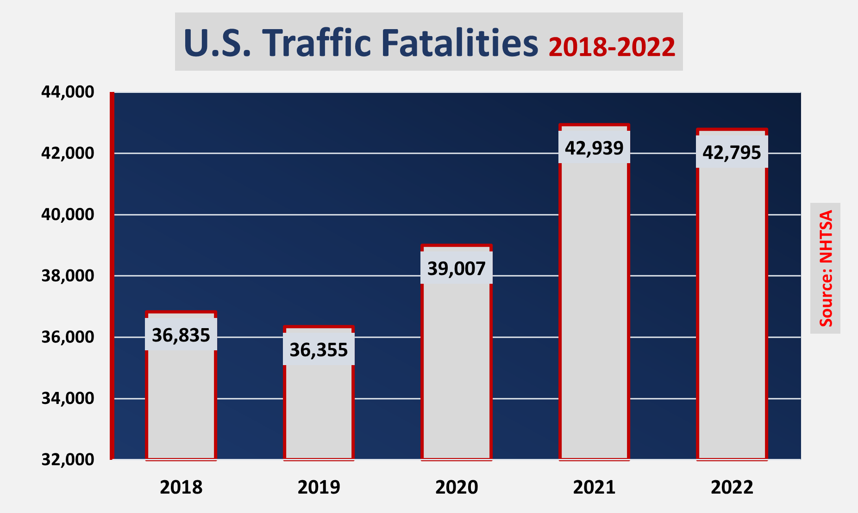

Slide 3
Aims
Study the most popular modern control techniques
Design Safe controller
Prepare simulation environment

Slide 4
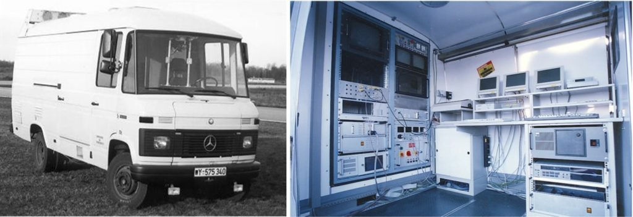
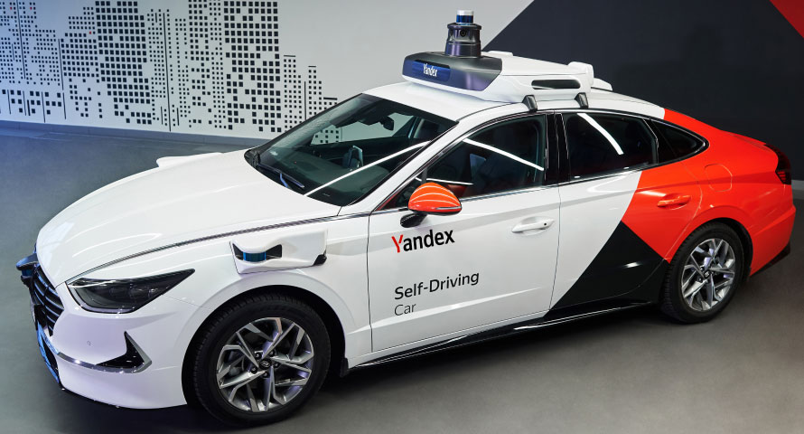
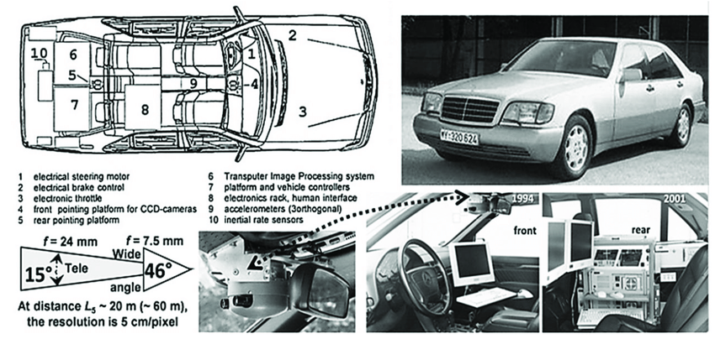
Historical overview
1939 - N.B.Geddes introduced concept of self-driving car
1980s - Ernst Dickmanns and Mercedes
Modern self-driving cars

Slide 5
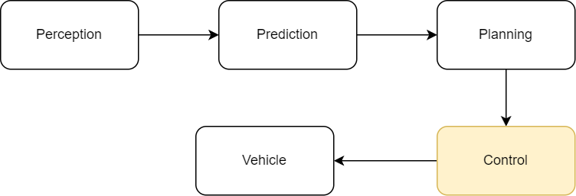
Main components of self-driving system

Slide 6
Control techniques
PID - model-free, unconstrained, hard to tune
LQR - linear optimal control, unconstrained, tuned with meaningful parameters
LMPC - linear optimal control, constrained
NMPC - nonlinear optimal control, constrained, expensive computations

Slide 7
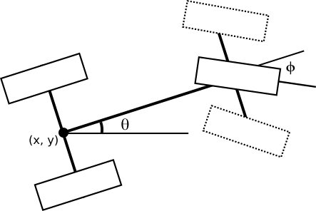
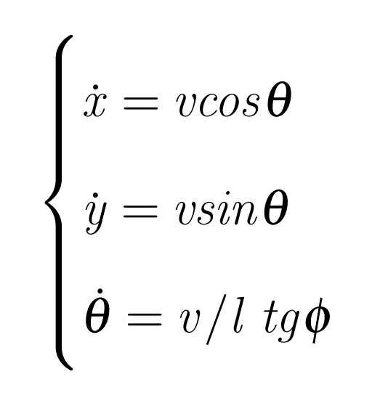
Car dynamics
Bicycle model

Slide 8
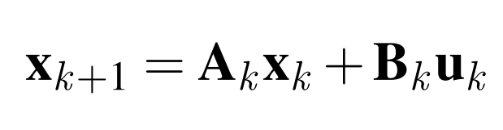
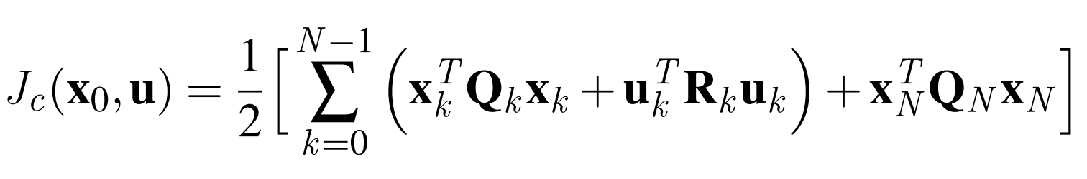
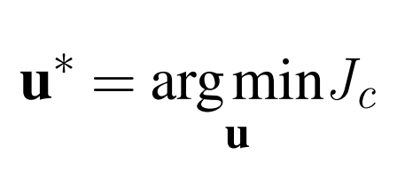
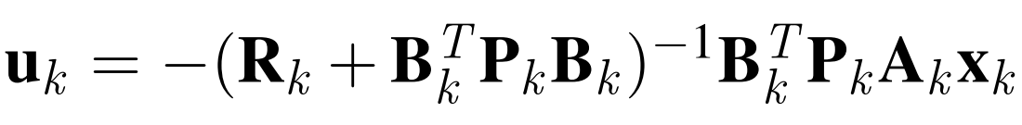
LQR
– Linear Discrete Time-Invariant Dynamical System
– cost function
Convex Optimization problem –
– Solution of Discrete Algebraic Riccati Equation

Slide 9
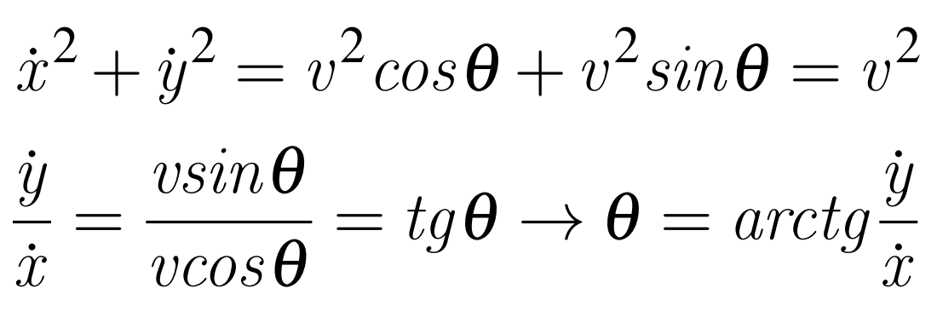
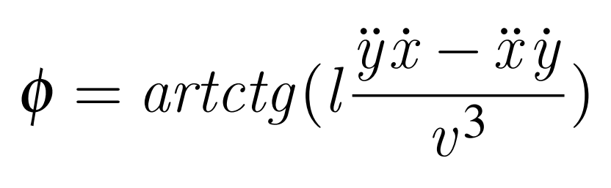
Differential Flatness
Sum of squares of Cartesian velocities –
Ratio of Cartesian velocities –
Hence,

Slide 10
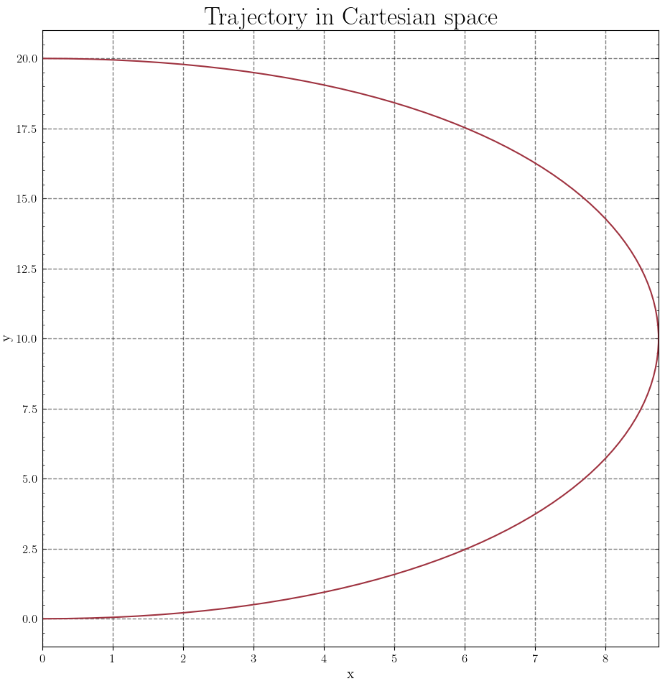
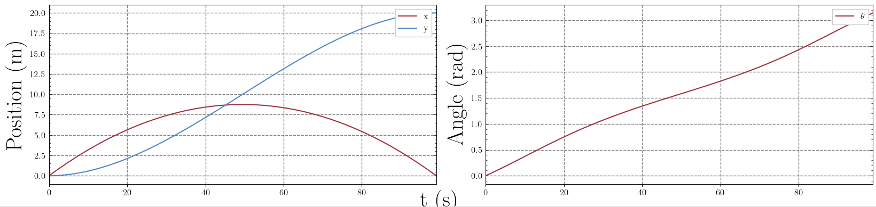
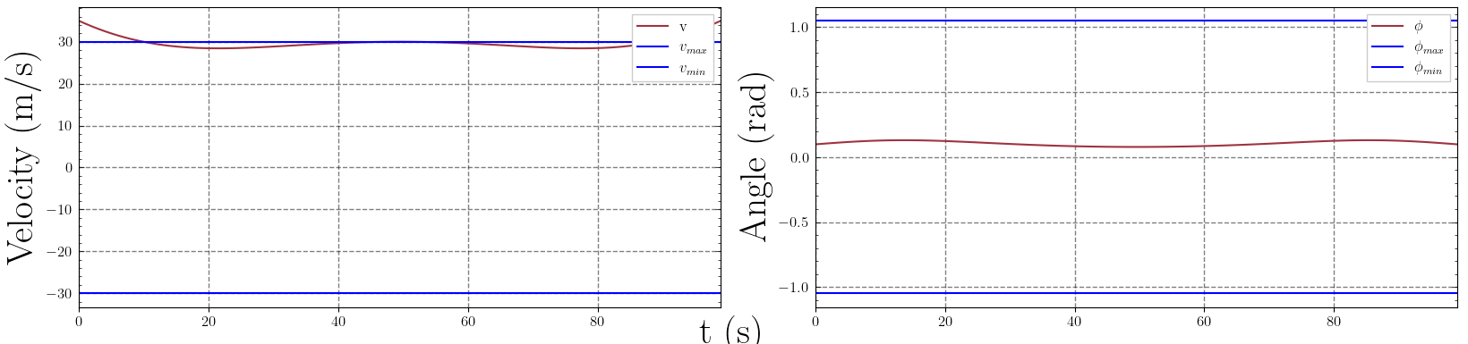
Differential Flatness

Slide 11
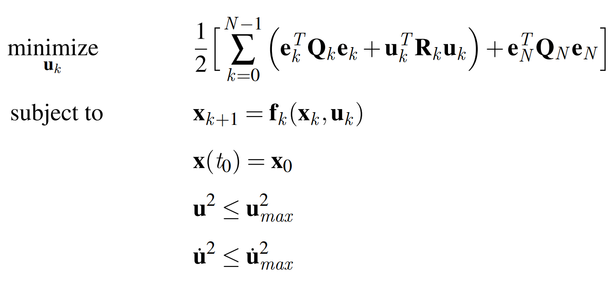
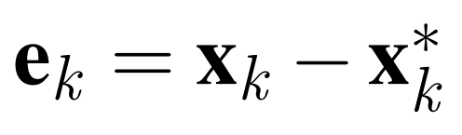
NMPC
Optimization problem statement:

Slide 12
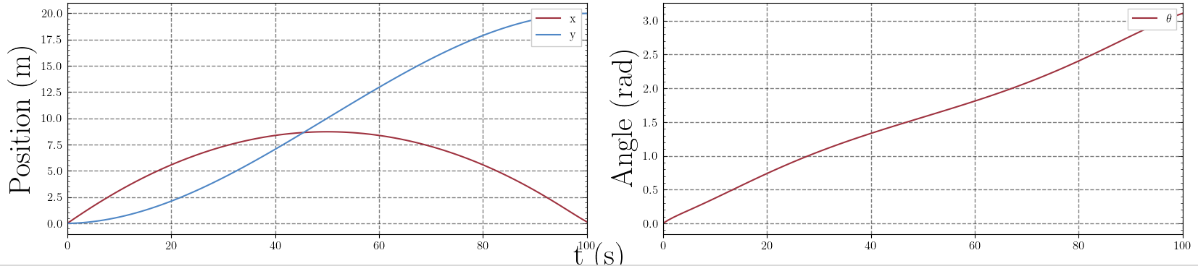
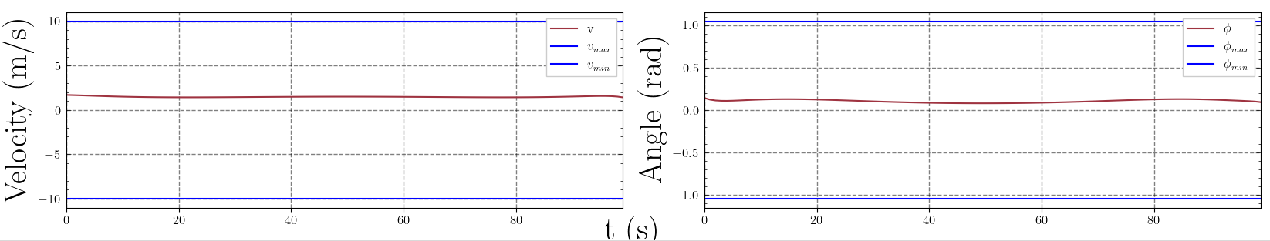
NMPC

Slide 13
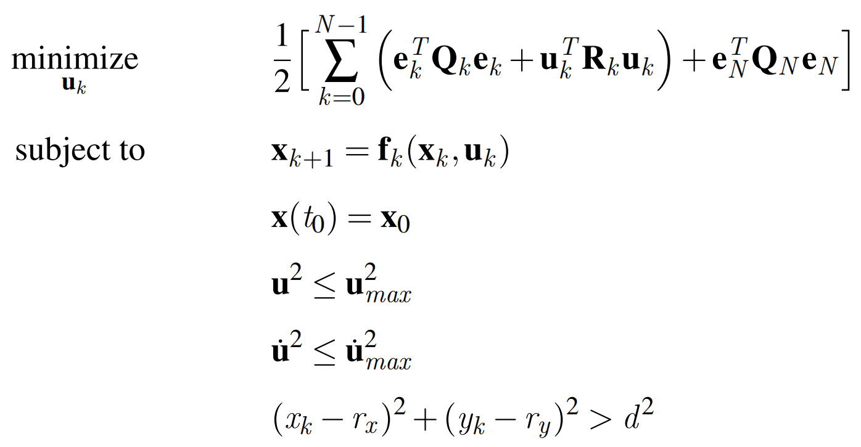
Safe MPC
Optimization problem statement:

Slide 14
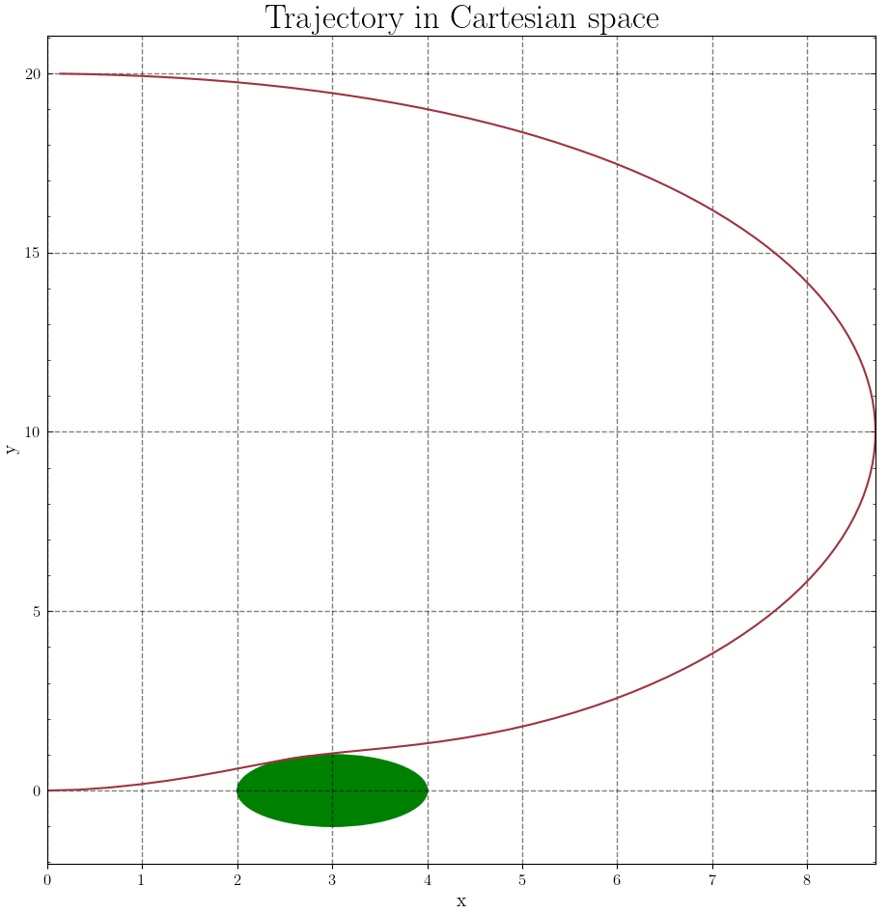
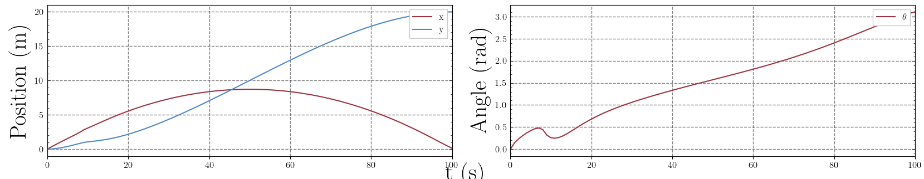
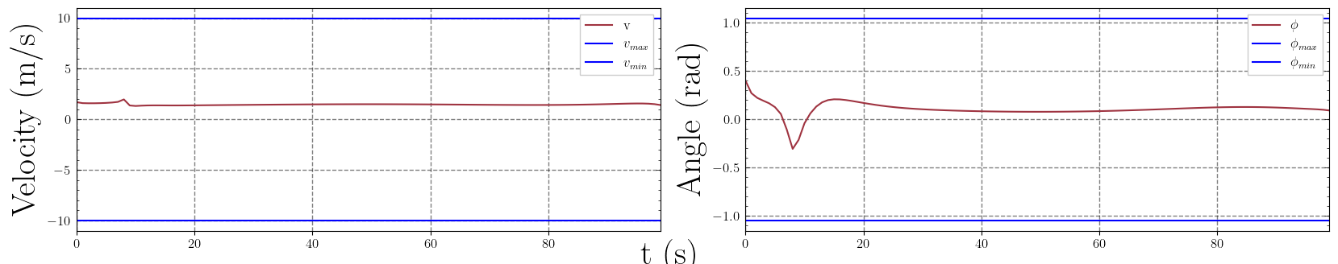
Safe MPC: Trajectory Optimization

Slide 15
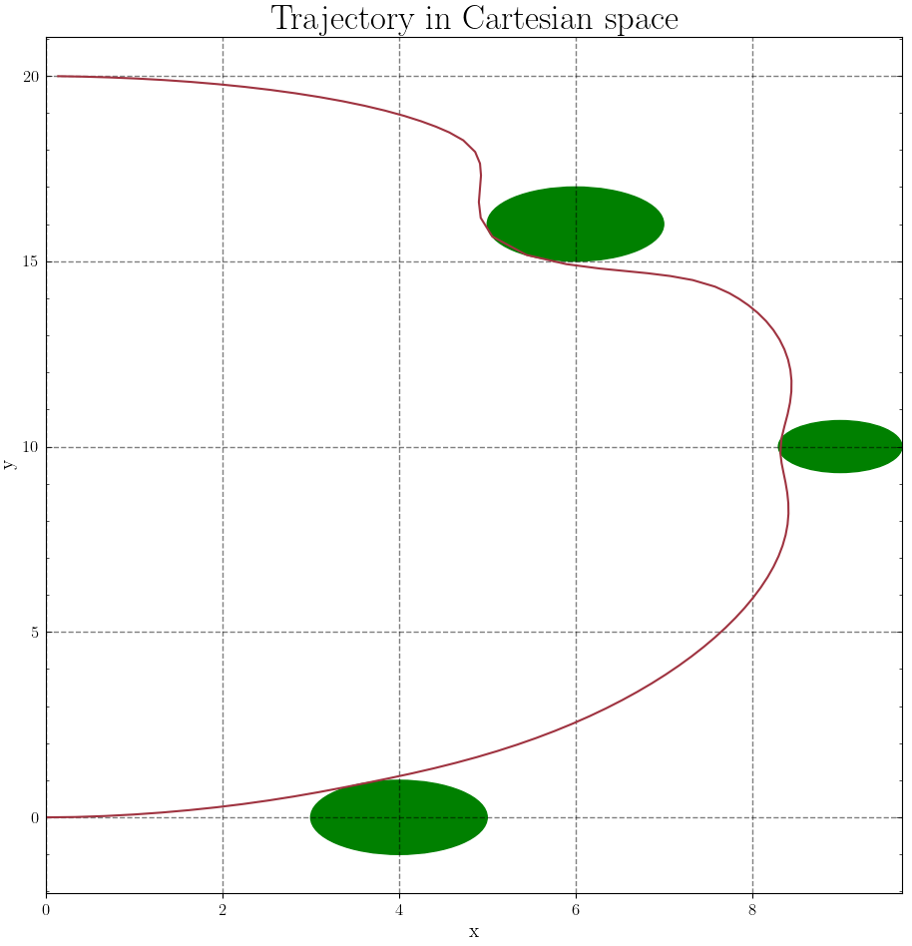
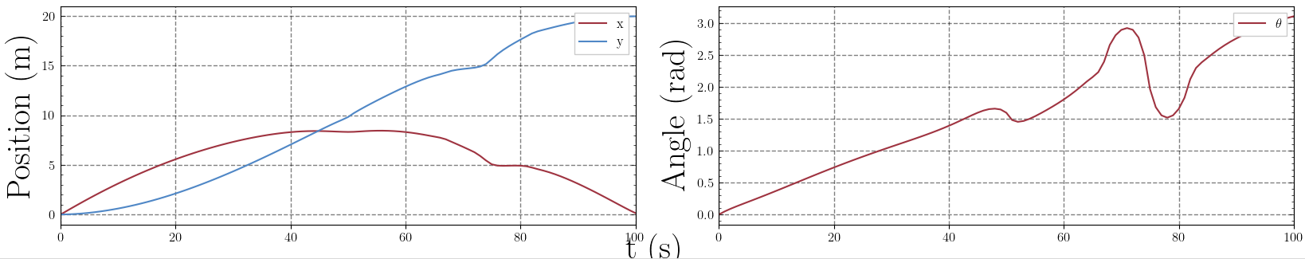
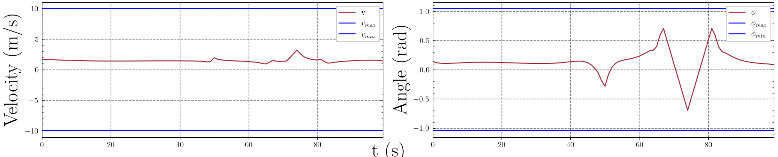
Safe MPC: Trajectory Optimization

Slide 16
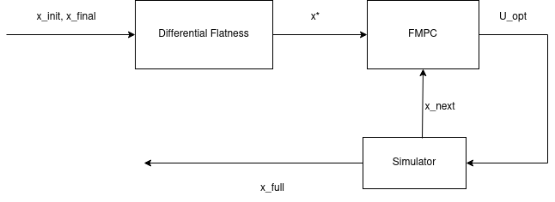
Simulation

Slide 17
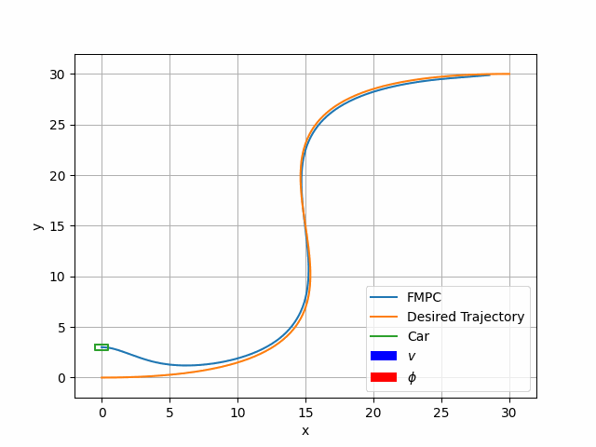
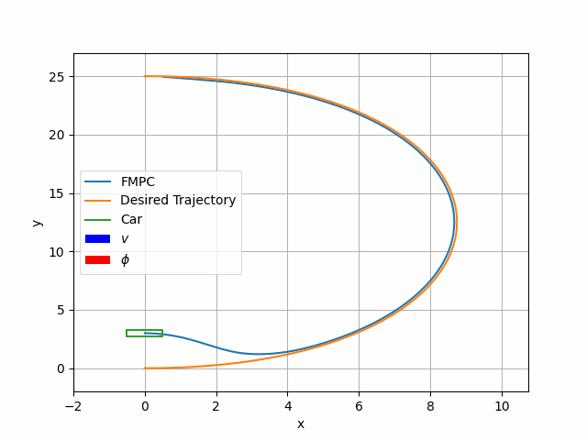
Simulation

Slide 18
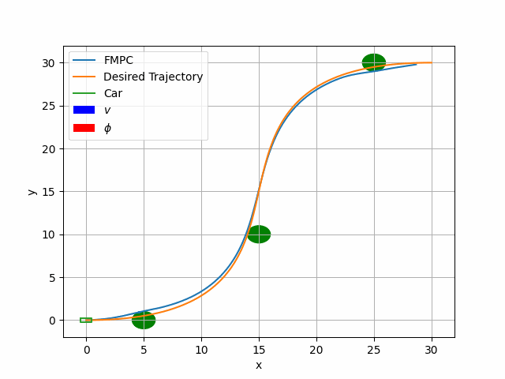
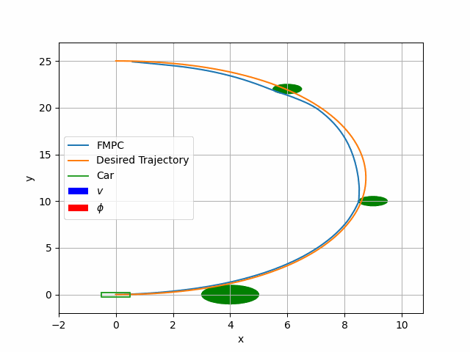
Simulation

Slide 19
Conclusion
After researching modern controllers for autonomous vehicles NMPC was chosen
Safety constraint added to NMPC
Prepared simulator with visualization
Tested obstacle avoidance

Slide 20
Future work
Add CBF to handle safety constraints - may improve tracking accuracy
Git

